Slide 1
Smart Plant Pot Design
By Oliver Richardson

Slide 2
What The Idea Is
A ‘Smart’ plant pot that can tell the user whether the location it is in has enough sunlight and when it needs to be watered.
The device will collect a selection of data such as:
  The current temperature
  The current humidity
  The last time it was watered
  When it will next rain
and then it will calculate the next time the plant should be watered before putting
itself into sleep mode to save power until just before that time where it will wake
up and wait for the user to water the plant and once the user waters the plant it
will recalculate when it should next be watered.
It will also recalculate when it should be watered by interrupting sleep if the plant is watered early/ it rains and calculating the time again.
To check when it has been watered the device can check for spikes in humidity or have the user input when they have watered it.

Slide 3
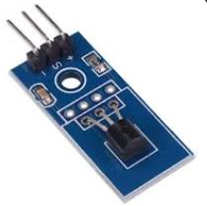
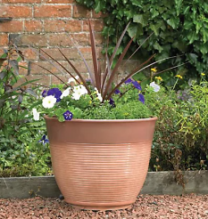
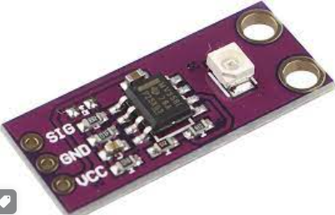
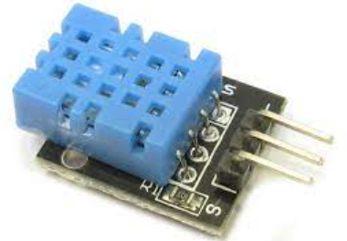
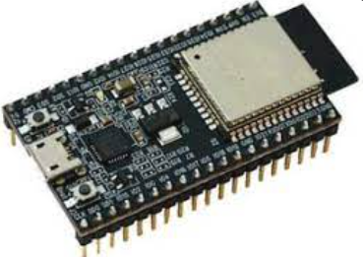
What The Idea Is
Temperature Sensor
Watering/Sunlight Alert
Sunlight Sensor
Humidity Sensor
User Smartphone
Main Board

Slide 4
What The Purpose Is
The device is intended to allow people who aren’t very good at keeping plants to keep a plant.
This is because keeping plants alive is a lot of work and this device will reduce the work involved in it by reminding the user what they need to do and removing any guess work involved in the process, such as when to water it and whether it has enough light as both of these require either experience in looking after plants or guess work.

Slide 5
What Sensors Would Be Needed
Thermal Sensors – to determine current temperature and the rate of water evaporation/consumption.
Humidity – to determine how fast water will evaporate based on ambient humidity.
Sunlight – to determine whether the plant needs to be moved based on the time of day i.e., if it is in the shade.
To know when the plant is watered it could either automatically detect raised Humidity or have a button that the user presses when they water it.
Some sensors have humidity and temperature together which would likely be a better option than using two separate sensors.
All sensors will need to be calibrated and have relevant thresholds set for when to send alerts based on this.
Could average between the last few readings and current to reduce outliers and anomalies.

Slide 6
What Actuators Would Be Needed
Indicator lights to tell the user that the plant needs watering or moving to a location with more sunlight.
Could also send notifications to the user's smartphone to tell them to water/move the plant.
If I had more time and was preparing this device for a commercial use, I could instead link to a Servo motor that blocks/unblocks a pipe leading to a water butt to water the plant itself, but this would require a more complex set up for the user's house so might not be possible in all cases. If this option is used, then the humidity sensor could be used to ensure the actuator has functioned correctly by checking for a sharp rise and alert the user if the actuator doesn’t work.

Slide 7
Network Connectivity
Connect to a weather API to avoid telling the user to water the plant when it is about to rain.
Could also get weather API info on other things like current temperature and humidity to use instead of the sensors but would be more info to pass along the network and can just be collected on site instead so would just create more unneeded traffic in the network.
Will use either blynk.io or arduino.cc or send data/alerts to the user's phone.
Send data via Wi-Fi to the blynk.io or Arduino.cc from the Arduino.
To ensure reliability the phone will need to send alerts if it becomes disconnected from the Arduino so that the user can reconnect it and the data will need to be sent via an appropriate protocol such as TCP.

Slide 8
Power Management
The device will put itself into sleep mode which will end when either:
  The device is watered, at which point it will recalculate when it should next be watered.
  The time it should next be watered has arrived and it needs to send out a notification to the user to water it.
This will reduce the power consumption of the device heavily as instead of always being on it will just turn on a few times for a short duration across the day.

